Slide 1
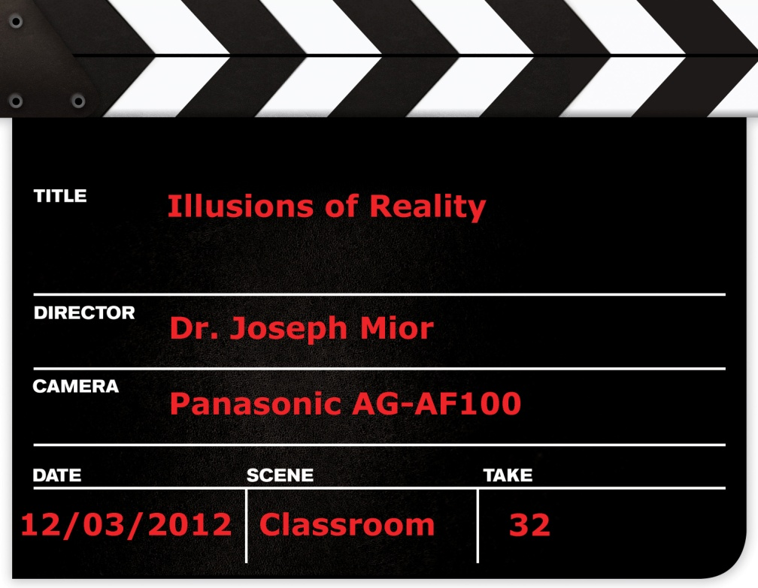
Film Genres
Making Movie Categories

Slide 2
Definitions
Genre:
a classification of films based on plot type and characters
No single system of genres exists.
Film genres are similar to literary genres.
Purpose
Helps define purpose of film
Allows viewer to
anticipate content before viewing
analyze content after viewing

Slide 3
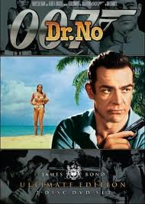
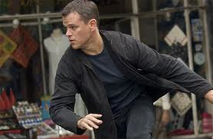
Action Films
Also called “Thrillers”
Features
Physical stunts and chases
Rescues, battles, fights, escapes
Destructive crises (floods, fires, explosions, tsunamis, etc.)
Fast pacing, non-stop motion
Two-dimensional characters (good guys, bad guys)

Slide 4
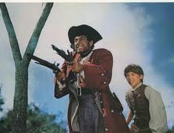
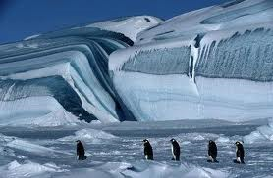
Adventure Films
Journeys to exotic locations: jungles, climax forests, savannahs, frozen wastelands.
Plots usually secondary.
May be fiction or documentary.

Slide 5
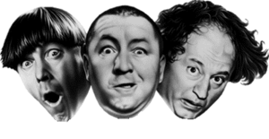
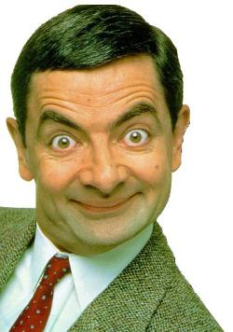
Comedy
Plots end on a positive note
Emphasis on resolution and community
Light tone to elicit amusement, laughter
Exaggerated plots, characters, situations, language, relationships
Categories
Slapstick: physical humour
Parody: exaggerated imitation of another genre
Romantic comedy: boy-girl relationships
Satire: questioning generally held beliefs

Slide 6
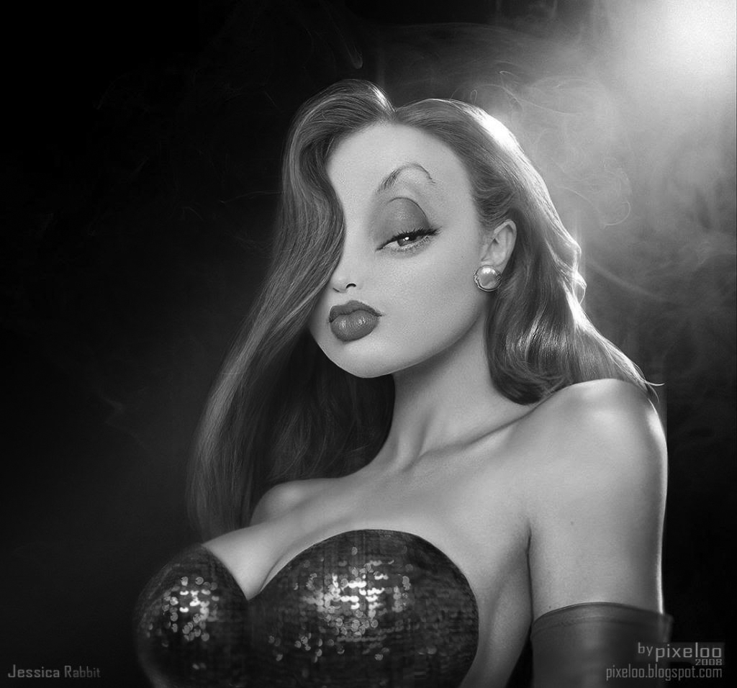
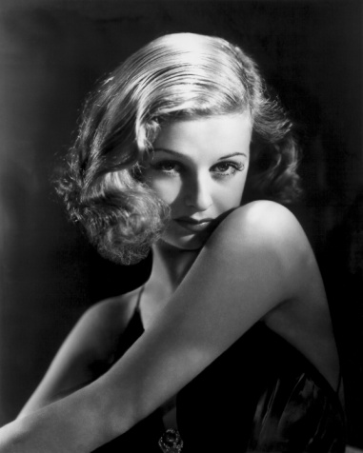
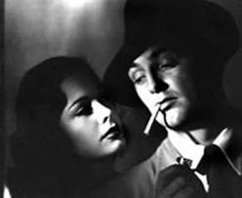
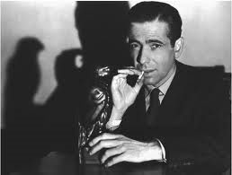
Film Noir
Called “noir” because often shot at night
Characteristics
plots involve murder
characters are hard-boiled, often cynical
one may be a femme fatale
setting is the city at night, often shot in black-and-white
Related to crime drama, gangster films, detective, and mystery films

Slide 7
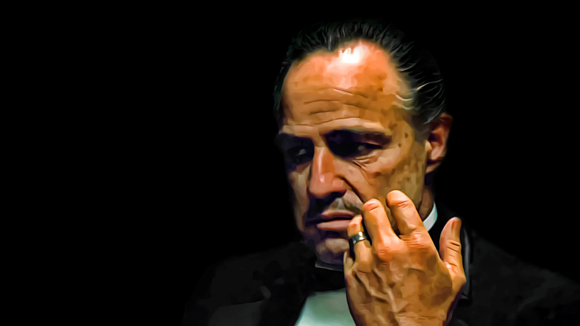
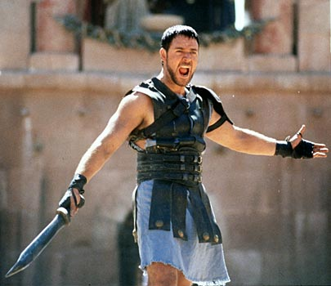
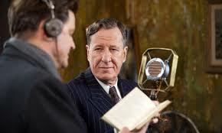
Drama
Plot driven
Realistic characters and settings
Intense emotions, focus on relationships
Categories
Historical drama: set in the past
Biographical drama: about real people
Epics: longer films with more characters, settings, time frames

Slide 8
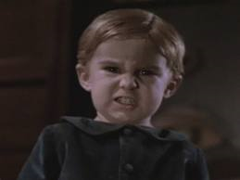
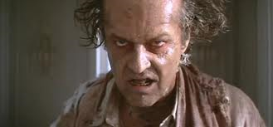
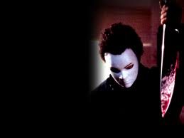
Horror Films
Plot and character designed to elicit fear.
Cathartic experience of fear
Usually surprise ending
Can have overtones of science fiction or fantasy

Slide 9
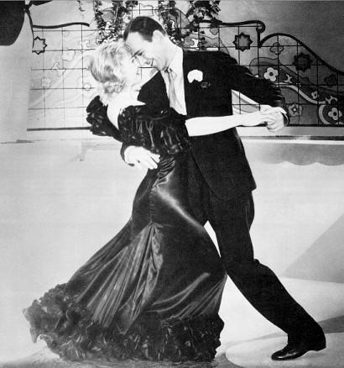
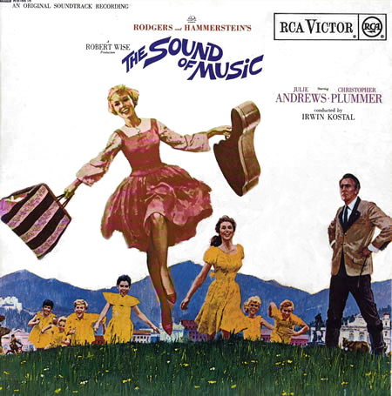
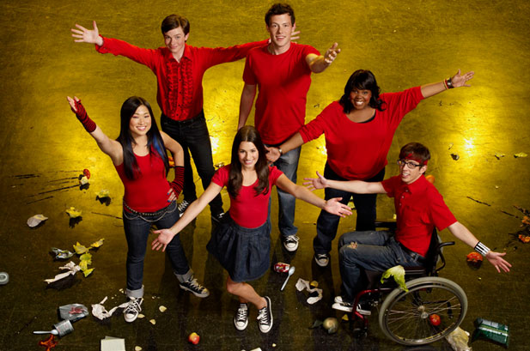
Musical Films
Music is main theme
Main characters are musicians
Often stage shows
Full-scale scores, song and dance routines
Categories
Broadway musicals
Biographies of musicians
Stage shows

Slide 10
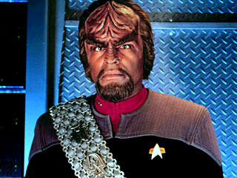
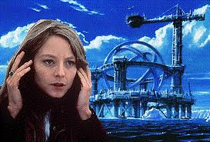
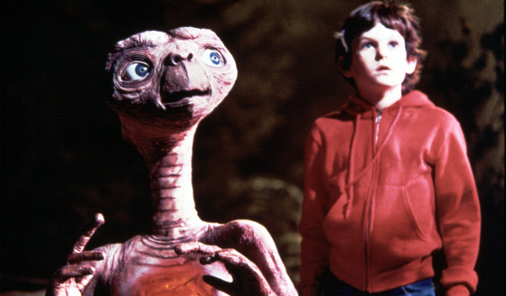
Science Fiction and Fantasy Films
Set in space or other worlds
Science fiction begins from science fact
more realistic characters and plots
Often based on utopia (ideal) or distopia (post-apocalyptic) settings

Slide 11
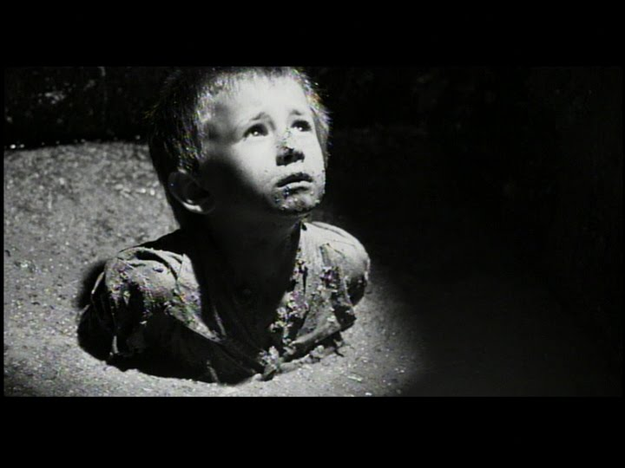
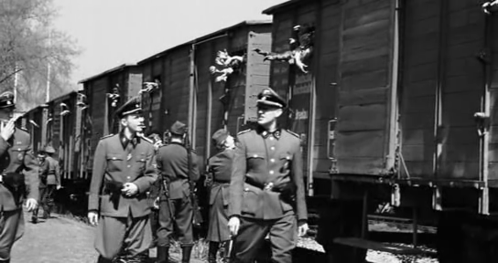
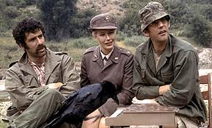
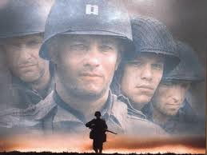
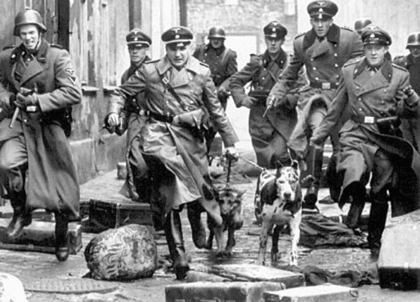
War Films
Plot driven
Usually recent history (20th century)
can be
realistic
fantasy or future world war
satiric

Slide 12
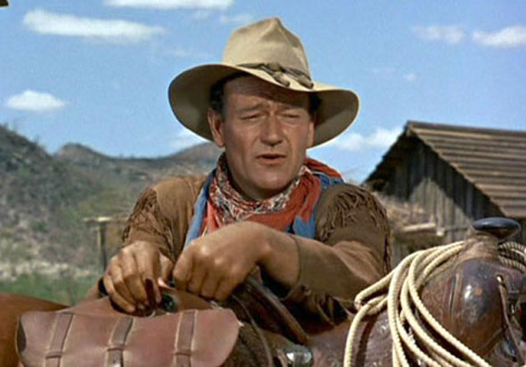
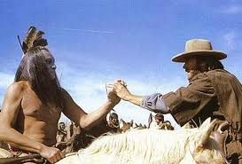
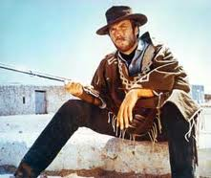
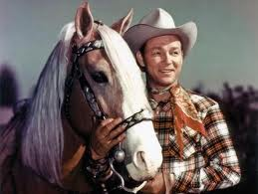
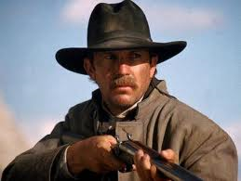
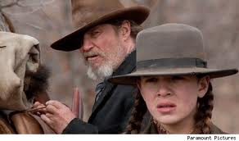
Western Films
Setting: old West (usually 19th century)
Themes: justice, good and evil
Characters: cowboys, Indians, sheriffs, etc.

